Slide 1



MICROCONTROLLER BASED SYSTEM DESIGN
CSE 3215
Lecture 5

Slide 2
AVR Microcontroller
The basic architecture of AVR was designed by two students of Norwegian Institute of Technology (NTH), Alf Egil Bogen and Vegard Wollan, and then was bought and developed by Atmel in 1996.
Atmel says that it is nothing more than a product name, but it might stand for Advanced Virtual RISC or Alf and Vegard RISC.
The AVR was one of the first microcontrollers to use on chip Flash memory for program storage.
Flash memory is a non-volatile programmable memory, ideal for fast development because Flash memory can be erased in seconds compared to the 20 minutes or more needed for the UV-EPROM.

Slide 3
AVR Features
In order to maximize performance and parallelism, the AVR uses a Harvard architecture
with separate memories and buses for program and data.
Instructions in the program memory are executed with a single level pipelining. While one instruction is being executed, the next instruction is pre-fetched from the program memory. This concept enables instructions to be executed in every clock cycle.
The program memory is In-System Reprogrammable Flash memory.

Slide 4
AVR Features
AVR microcontroller program ROM
In microcontrollers, the ROM is used to store programs and for that reason it is called program ROM.
Although the AVR has 8M of program ROM space, not all family members come with that much ROM installed.
The on chip program ROM size can vary from 1K to 256K.
The AVR was one of the first microcontrollers to use on chip Flash memory for program storage.

Slide 5
AVR Features
AVR microcontroller data RAM and EEPROM
The AVR has a maximum of 64k bytes of data RAM space. Not all of the family members come with that much RAM.
The data RAM space has three components: general-purpose registers, I/O memory and internal SRAM.
There are 32 general purpose registers in all of the AVRs but the SRAM’s size and the I/O
memory’s size varies from chip to chip.
In AVR, a small amount of EEPROM is used to store critical data that does not need to be changed very often.

Slide 6
AVR Features
AVR microcontroller I/O pins
The number of ports in the AVR family varies depending on the number of pins on the chip.
The 8 pin AVR has port B only, while the 64 pin version has ports A through F, and the
100 pin AVR has ports A through L.
The 40 pin AVR has four ports. They are PORTA, PORTB, PORTC and PORTD.
The number of pins for the AVR package goes from 8 to 100 at this time.
AVR microcontroller peripherals
Most of the AVRs come with ADC (analog to digital converter), timers, and USART as standard peripherals.

Slide 8
AVR Features
AVR family Overview: AVR can be classified into four groups:
Classic AVR(AT90SXXXX):
This is the original AVR chip, which has been replaced by newer AVR chips.
Mega AVR(ATmegaXXXX):
These are powerful microcontrollers with more than 120 instructions and lots of different peripheral capabilities, which can be used in different designs.
Some of their characteristics are as follows:
Program memory: 4k to 256K bytes
Package: 28 to 100 pins
Extensive peripheral set
Extended instruction set: They have rich instruction sets.

Slide 9
AVR Features
AVR family Overview:
Tiny AVR(ATtinyXXXX):
As its name indicates, the microcontrollers in this group have less instructions and smaller packages in comparison to mega family. It is possible to design systems with low costs and power consumptions using the Tiny AVRs.
Some of their characteristics are as follows:
Program memory: 1k to 8K bytes
Package: 8 to 28 pins
Limited peripheral set
Limited instruction set: The instruction sets are limited.
Special purpose AVR:
The ICs of this group can be considered as a subset of other groups, but their special capabilities are made for designing specific applications.

Slide 10
AVR Features
ALU
The high-performance AVR ALU operates in direct connection with all the 32 general purpose working registers. Within a single clock cycle, arithmetic operations between general purpose registers or between a register and an immediate are executed.
The ALU operations are divided into three main categories: arithmetic, logical, and bit- functions.

Slide 11
The General Purpose Registers in the AVR
AVR microcontrollers have many registers for arithmetic and logic operations.
The majority of AVR registers are 8-bit registers.
In AVR there are 32 general purpose registers. They are R0-R31 and are located in the
lowest location of memory address. All of these registers are 8-bits.
They always take the address location $00-$1F in the data memory space, regardless of the AVR chip number.
To understand the use of the general purpose registers, we need know LDI and ADD
instructions.

Slide 12
LDI instruction
The LDI instruction copies 8-bit data into the general purpose registers. It has the following format:
LDI Rd, K
; load Rd with Immediate value k
; d must be between 16 and 31
K is an 8 bit value that can be 0-255 in decimal, 00-FF in hex, Rd is R16 to R31.
The “ I “ in LDI stands for “immediate.”
The following instruction loads the R20 register with a value 0x25 (25 in hex).
LDI R20, 0x25
To present a number in Hex, we must have to put dollar sign ($) or a 0x in front of it.
LDI R16 , 0x50 ; R16 is loaded with 50 in hex
For decimal representation, nothing is required to put in front of a number.
LDI R16 , 50 ; R16 is loaded with 50 in decimal

Slide 13
ADD instruction
The ADD instruction has the following format:
ADD Rd, Rr
; ADD Rr to Rd and store the result in Rd
; o≤d≤31 & 0≤r≤31
The ADD instruction tells the CPU to add the value of Rr to Rd and put the result back into
the Rd register.
To add two numbers such as 0x25 and 0x34, one can do the following :
LDI R16 , 0x25 LDI R17 , 0x34 ADD R16,R17
; R16 is loaded with 25 in hex
; R17 is loaded with 34 in hex
; add value R17 to R16 ( R16 = R16 + R17)

Slide 14
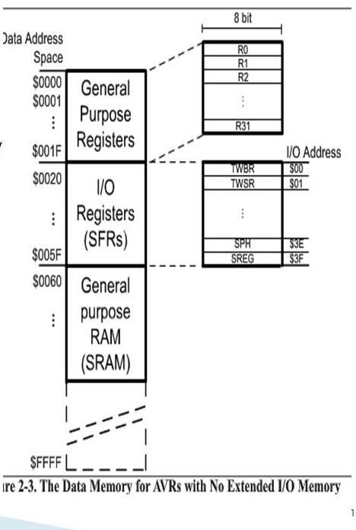
The AVR data memory
In AVR the data memory is
composed of three parts:
GPRs
I/O memory
Internal data SRAM

Slide 15
The AVR data memory
General Purpose Registers (GPRs)
Discussed in the last section
I/O memory (SFRs)
The I/O memory is dedicated to specific functions such as status register, timers, serial communication, I/O ports, ADC and so on.
The function of each I/O memory location is fixed by the CPU designer at the time of design because it is used for control of the microcontroller or peripherals.
The AVR I/O memory is made of 8-bit registers.

Slide 16
The AVR data memory
I/O memory (SFRs)
The number of locations in data memory set aside for I/O memory depends on the pin numbers and peripheral functions supported by that chip, although the number can very from chip to chip even among members of the same family.
However, all of the AVRs have at least 64 bytes of I/O memory locations.
In AVRs with more than 32 I/O pins ( eg., ATmega64, ATmega128 and ATmega256) there is also an extended I/O memory, which contains the registers for controlling the extra ports and the extra peripherals.

Slide 17
The AVR data memory
Internal Data SRAM
While the registers are used to perform calculations, the SRAM is used to store data during runtime.
SRAM are memories that are not directly accessable to the central processing unit (Arithmetic and Logical Unit ALU, sometimes called accumulator) like the registers are.
In AVR , the size of SRAM can vary from chip to chip, even among members of the same family.

Slide 18
THANK YOU

